Slide 1


PROJECT-TITLE
Presented By:
STUDENT NAMES
PROGRAM-YEAR/Sem
Date
Under the Guidance: **********

Slide 2
CONTENTS
ABSTRACT
INTRODUCTION
LITERATURE SURVEY
PROBLEM FORMULATION
METHODOLOGY
RESULTS
CONCULSION AND FUTURE SCOPE

Slide 3
ABSTRACT
Facial direction detection, a crucial aspect of computer vision and human-computer interaction, plays a pivotal role in numerous applications, ranging from surveillance systems to human-computer interfaces.
The methodologies employed in facial direction detection. Traditional approaches relied on handcrafted features and machine learning algorithms, whereas modern techniques leverage deep learning architectures, particularly convolutional neural networks (CNNs), to extract intricate facial features and infer direction robustly .
The face direction is estimated on the basis of the position of the pupils and face contour. The detection of faces and the estimation of the face direction from an image where their sizes, positions and poses are unknown. As the candidate regions of the face.

Slide 4
INTRODUCTION
Face detection and face direction estimation are important for face recognition. In personal identification with surveillance cameras, for example, it is necessary to detect the face whose size, position, and pose are unknown.
After the face detection, the face direction estimation is useful for the correct face recognition because we can select the face image of the most desirable direction from the face images taken by the multiple cameras.
At its core, face direction detection involves analyzing facial features, such as the eyes, nose, and mouth, to infer the direction in which a person is facing relative to the camera.
Accurately detecting facial orientation poses several challenges, including variations in lighting conditions, occlusions, and head pose changes. Overcoming these challenges is essential for robust and reliable facial orientation recognition systems.

Slide 5
LITERATURE SURVEY
Real-Time Face Detection " by Arpit Jain et al”: This paper presents a real-time face detection and tracking system implemented in Java. It explores techniques for face detection using Haar cascades and Kalman filters for face tracking. Although not specific to HTML, the methodologies discussed can be adapted for integration with HTML-based web applications.
Face Detection by “Arpit Jain et “:This paper presents a real-time face detection and tracking system implemented in Java. It explores techniques for face detection using Haar cascades and Kalman filters for face tracking. Although not specific to HTML, the methodologies discussed can be adapted for integration with HTML-based web applications.
Face Direction by “Jarjees A. Khidi”: In this paper, a method for detecting the direction of a human face is developed; regardless of its age or sex. The method involves creating a set of five face patterns representing the front, up, down, left, and right directions of a face.
Face detection methods by “anjeana.n “,”k.anusudha”: Face detection and recognition are two important areas of research in computer vision that have received significant attention over the past few decades. With the increasing availability of image and video data, automated identification of individuals based on their facial features has become an essential task in many applications.

Slide 6
PROBLEM FORMULATION
The problem formulation for face direction detection involves designing a system that accurately estimates the orientation or direction in which a detected face is pointing within an image or video frame.
Face Detection: Develop algorithms to detect and localize faces within input images or video streams.
Facial Landmark Detection: Design methods to identify and locate key facial landmarks, such as the eyes, nose, and mouth, which serve as reference points for estimating face direction.
Orientation Estimation: Implement techniques to estimate the orientation of the face based on the positions of detected facial landmarks.
Post-processing: Incorporate post-processing techniques such as filtering or smoothing to refine the estimated face direction and mitigate noise or jitteriness in the output.
Evaluation: Establish metrics and datasets for evaluating the accuracy and performance of the face direction detection system, allowing for iterative refinement and optimization.

Slide 7
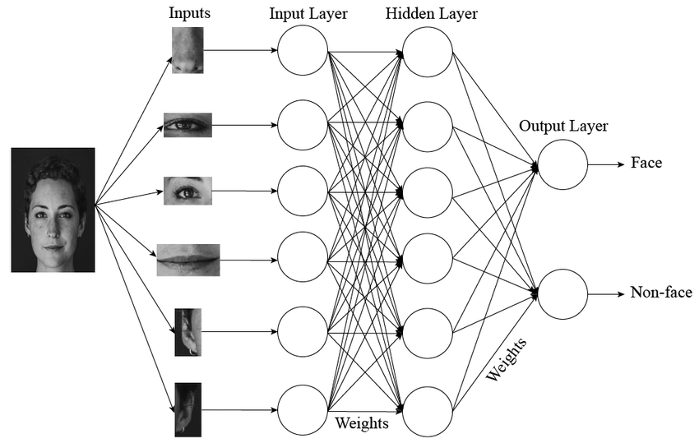
METHODOLOGY
Convolutional Neural Networks (CNNs) have become the dominant approach in face detection and pose estimation due to their ability to learn complex patterns directly from data.
The performance of the face direction detection system is evaluated using appropriate metrics and datasets, facilitating further optimization and refinement to meet specific application requirements.

Slide 8
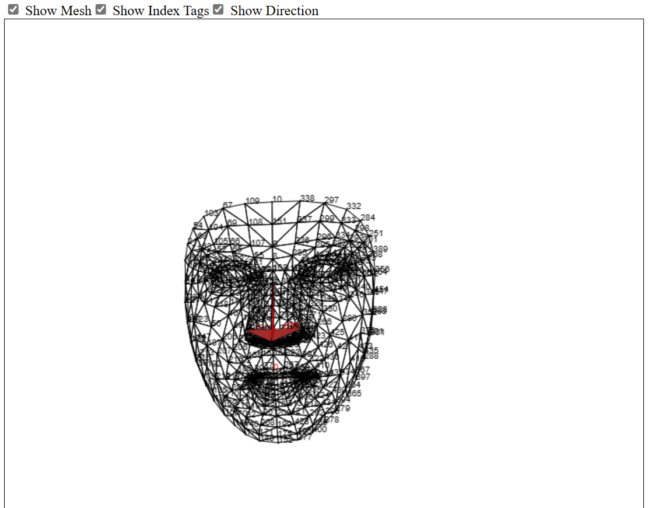
RESULT
The face direction detection is the estimation of the orientation or direction in which a detected face is pointing within an image or video frame. This output provides valuable information for various applications, including human-computer interaction, surveillance, augmented reality, and emotion recognition systems.

Slide 9
CONCLUSION
The methodology for face direction detection encompasses a series of steps in computer vision, starting with face detection and progressing through landmark detection, orientation estimation, and post-processing techniques. The accuracy and reliability of the result heavily rely on the effectiveness of each step in the process. By accurately estimating the direction in which a detected face is pointing, these systems enable various applications across different domains. As technology continues to advance, further refinements and optimizations in these methodologies will likely lead to even more precise and robust face direction detection systems, opening up new possibilities for interaction and analysis in numerous fields.

Slide 10
FUTURE SCOPE
The future scope for face direction detection is promising, with potential advancements in several areas:-
Improved Accuracy: Future research could focus on enhancing the accuracy and robustness of face direction detection algorithms by leveraging more sophisticated deep learning architectures, larger and diverse datasets, and novel training techniques.
Real-time Applications: There's a growing demand for real-time face direction detection in applications such as human-computer interaction, virtual reality, and augmented reality.
3D Face Modeling : Advancements in 3D face modeling techniques could enable more accurate estimation of face direction by incorporating depth information, leading to better understanding and interpretation of facial poses and expressions
Contextual Understanding: Integrating contextual information such as scene analysis and environmental cues could enhance the interpretation of face direction in complex scenarios, improving the overall performance of face direction detection systems.

Slide 11


